Slide 1

NBA Questions:
Asked & Answers
Daniel Haven, Aaron Oyer, Mark Stalnaker

Slide 2
We wanted to explore the relationships between salary, performance and popularity of NBA players. We used 2016-2017 season data for individual players and teams to answer various questions about these relationships. We are all NBA fans and are interested in how analytics are changing the game.
Data:
Used multiple sets of NBA data found on Kaggle
Twitter API
Issues:
Players listed multiple times (if traded in-season)
Players listed with blank stats
Drafted vs undrafted players
Mapping issues

Slide 3
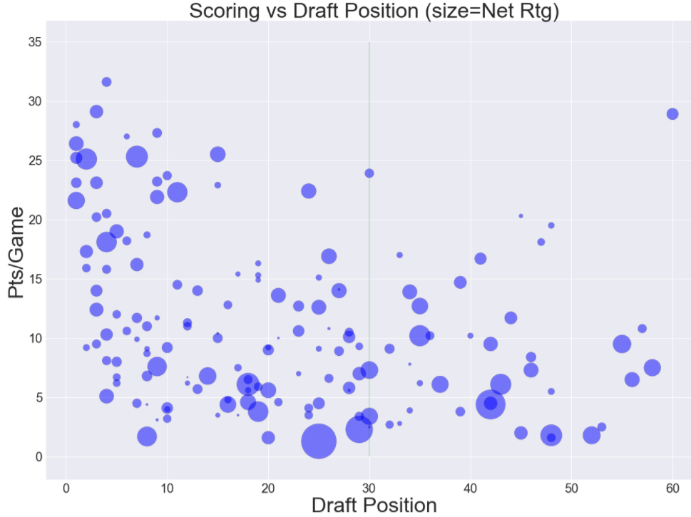
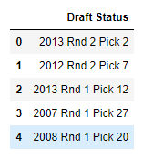
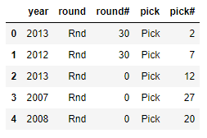
Where are the best scorers drafted?

Slide 4
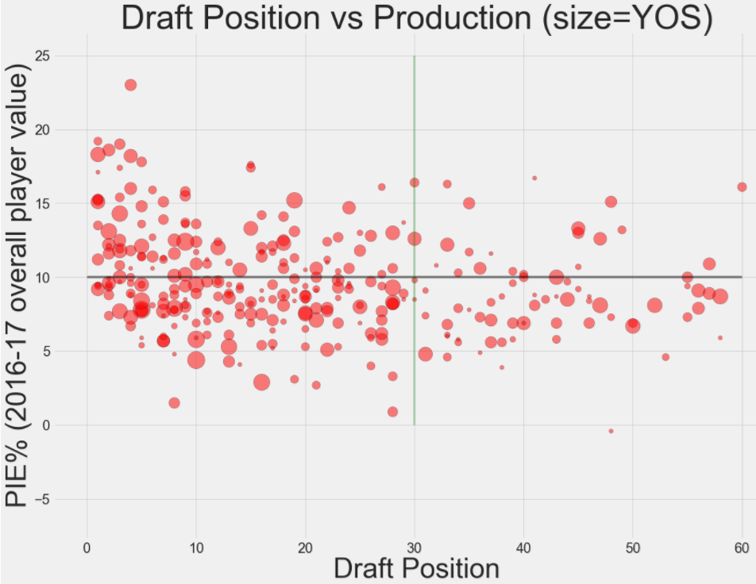
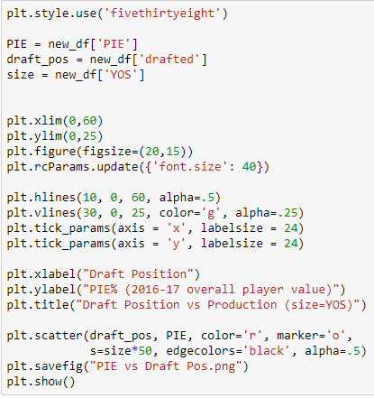
From NBA.com: "In its simplest terms, PIE shows what % of game events did that player or team achieve. The stats being analyzed are your traditional basketball statistics. A player that achieves more than 10% is likely to be better than the average player. A high PIE % is highly correlated to winning. In fact, a team’s PIE rating and a team’s winning percentage correlate at an R square of .908 which indicates a "strong" correlation."

Slide 5
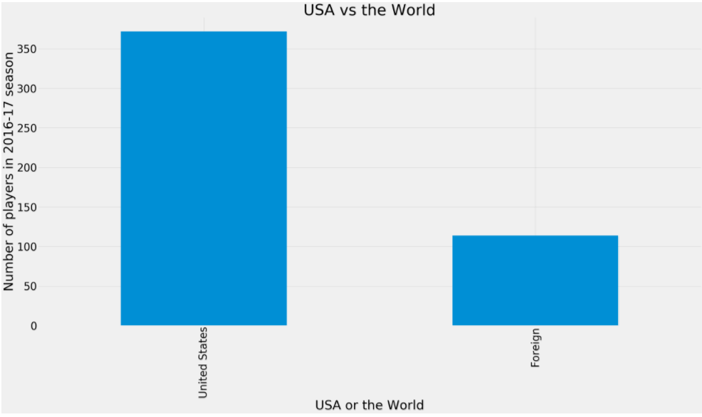
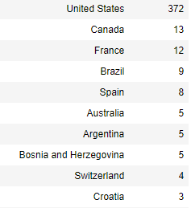
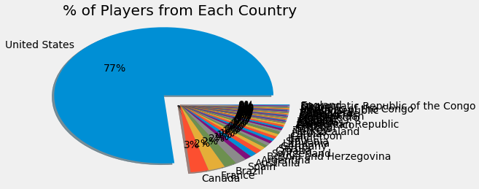
Where do NBA players come from?
Hoped to show what countries NBA players are from in a map
Unfortunately ran into multiple issues doing so
Another tool (such as Tableau) would have been better to show this
Even with influx of foreign players in last 10 years, USA still dominates the league with 77% of players as of 2016-17 season

Slide 6
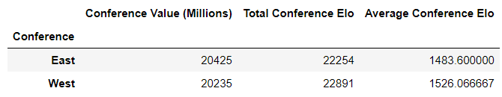
Basic Conf Metrics

Slide 7
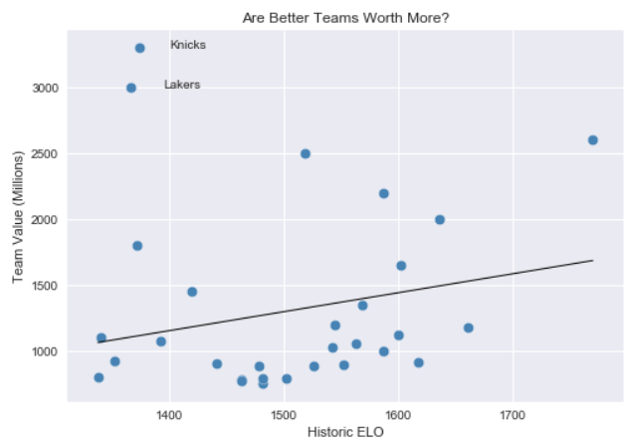
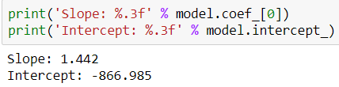

Are Better Teams Worth More?

Slide 8
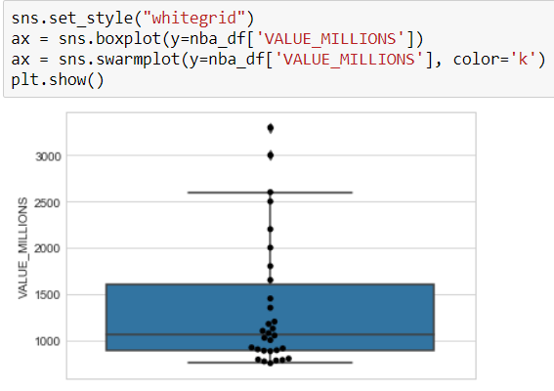
Identifying and Removing Outliers

Slide 9
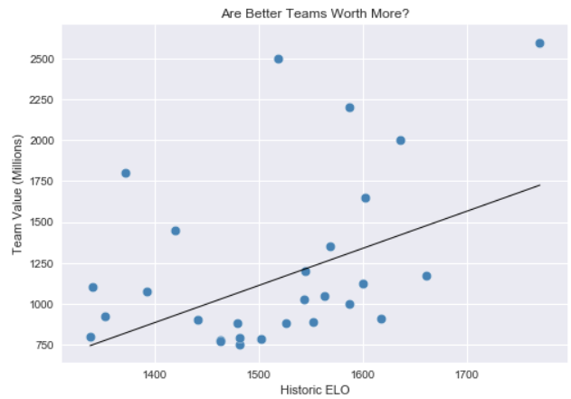
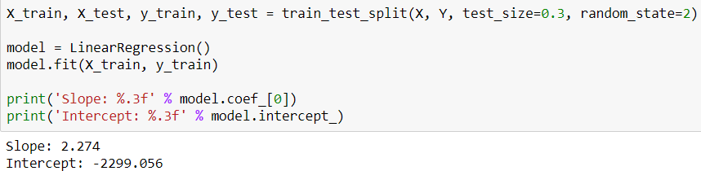

Rerun Regression without Outliers

Slide 10
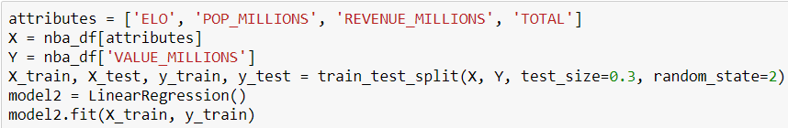
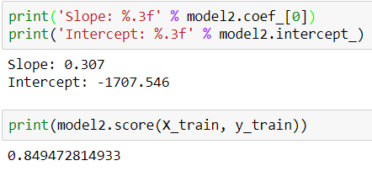
Multivariable Regression

Slide 11
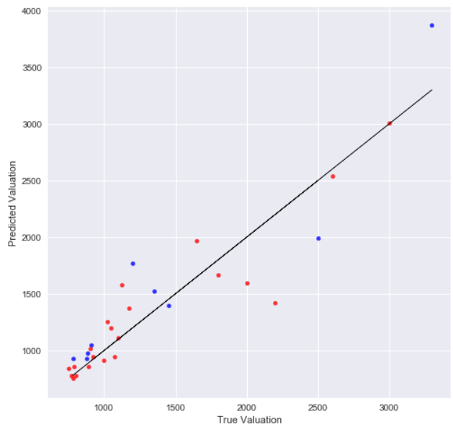
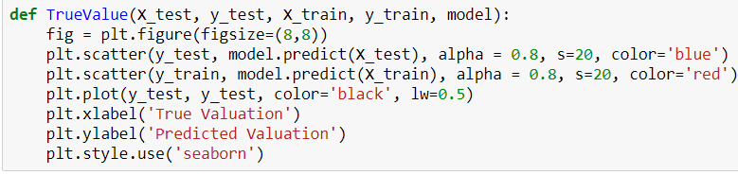
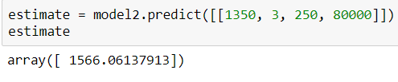
Multivariable Regression

Slide 12
NBA “Bigs”:
Role of C’s and PF’s changing to beyond the arc
Over the last few seasons, the theory is that there has been a sea change in the role of bigs in the NBA- a switch from guys playing close to the basket with an emphasis on rebounds and blocks to the value being moved to players who can shoot 3s.

Slide 13
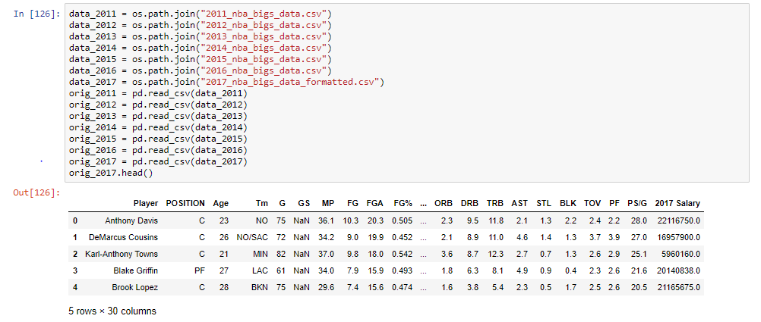
Pulled data from last seven seasons, using only players whose position was listed as PF or C (i.e. “Bigs”), as they historically take few 3-point shots and play near the basket

Slide 14
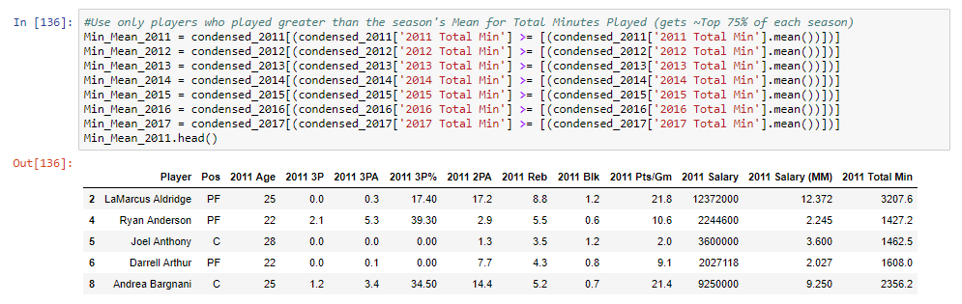
To get a true representation of trend, used only players who logged at least the league average in total minutes for a season

Slide 15
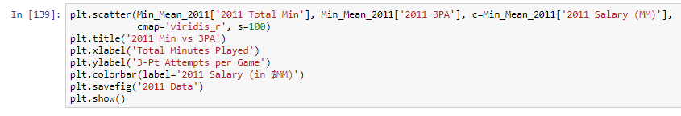
Used a “heat map” to show the correlation between the number of 3-point attempts by year vs the total season minutes played, using salary to show the players who are making the most.
Also used value_counts to list number of qualifying players for the given year.

Slide 16
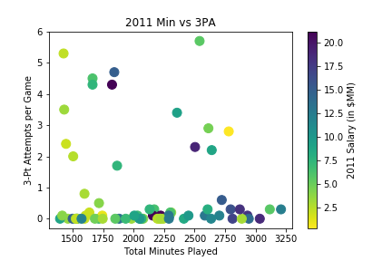

2011

Slide 17
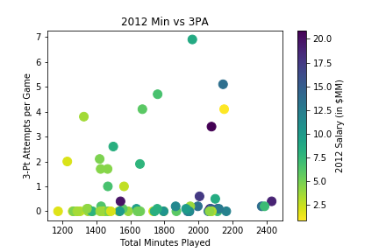

2012

Slide 18
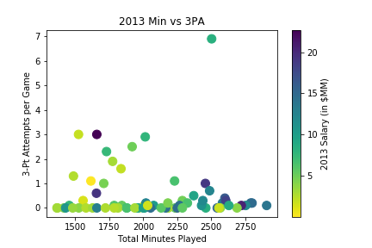

2013

Slide 19
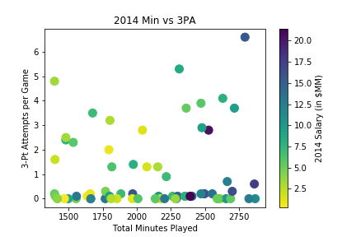

2014

Slide 20
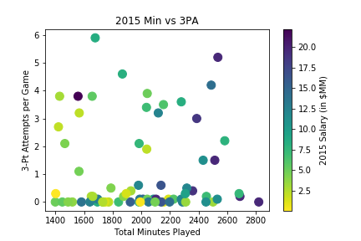

2015

Slide 21
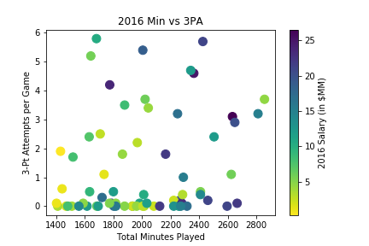

2016

Slide 22
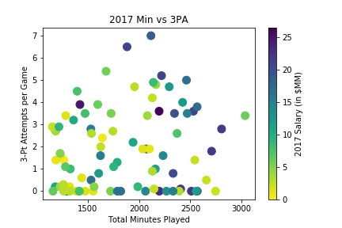

2017

Slide 23
2011-2017
Data shows a huge change in the role of NBA bigs

Slide 24
NBA Twitter:
Who tweets most, Twitter followers vs Min/Gm or $$$
Any correlation in player minutes or player salaries and the number of their Tweets

Slide 25
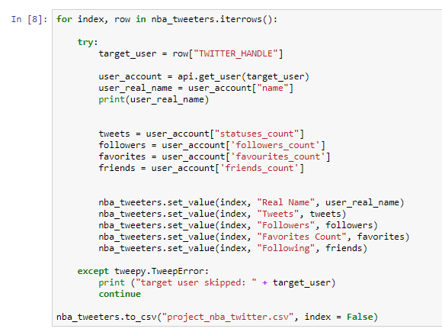
Used Twitter API and a Kaggle csv with around 100 players including their Twitter handle

Slide 26
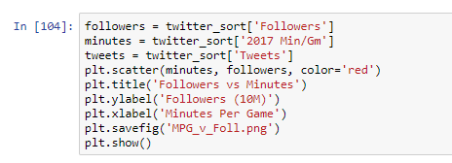
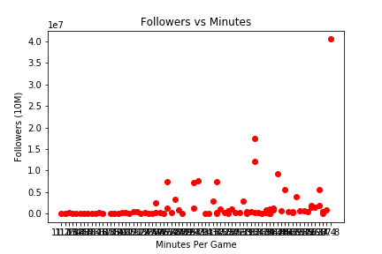
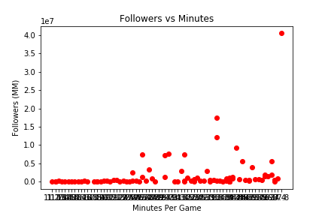
Plotted graph using minutes plus Twitter followers
Thanks, LeBron!
One outlier skewed the whole graph and made it unreadable

Slide 27
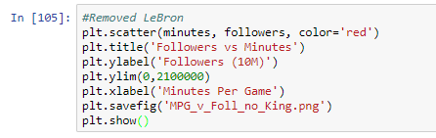
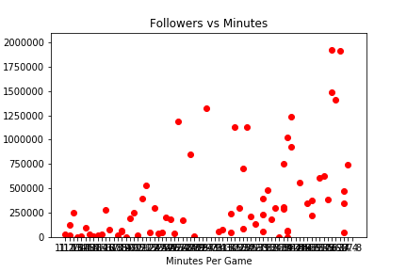
Removing LeBron James (>40M followers, almost double 2nd place), we get a much more readable plot
As expected, more minutes played starts to equal more followers on Twitter

Slide 28
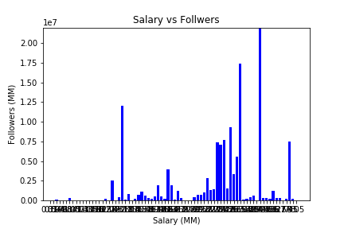
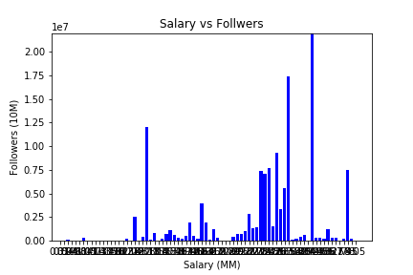
Again removing LeBron, did the same for salary vs followers
Top salaries weren’t necessarily the most followed… around the 67th percentile was the winner in follows.

Slide 29
Thanks for listening!
Now, time for questions...

